Slide 1



a00s3e3 - DONE
F= -1.77969
F = -1.77893
F= -1.77588, unstable

Slide 2










a00s5e3 - DONE
F = -2.986
F = -2.98574
F = -2.98733
F = -2.98580
F = -2.98637
F = -2.98644

Slide 3


a00s6e3 - DONE
F = -3.59170
F = -3.59404

Slide 4


a00s7e3 - DONE
F = -4.20090
F = -4.20224
Terran tried stripe (15.2, 20.2) & (12.2, 20.2). Unstable

Slide 5



a05s3e3 - DONE
F = -1.77283
F = -1.77232
F = -1.77005

Slide 6



a05s5e3
F = -2.97229
F = -2.97422
F = -2.97365

Slide 7
a05s6e3 - TERRAN
Hol – init from a05s5e3. try same first, then less and greater
Str – init from a05s5e3. try 24.2 first
Hom. Lxly 20 only

Slide 8
a05s7e3 - TERRAN
Str – init from a05s6e3
Hol – init from a05s6e3
Hom. Lxly20 only

Slide 9



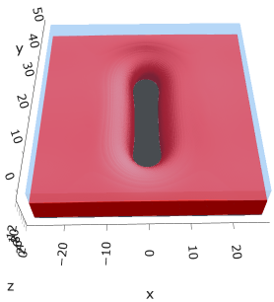

a10s5e3 - DONE
F = -2.93788
F = -2.93873
F = -2.93788

Slide 10
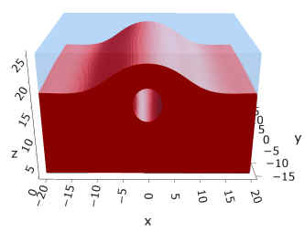
a10s010 - JOSH
Hol – init from a10s5e3. Try lower, same, and higher box sizes
Str – init from a20s015. Try lower, same, and higher box sizes
Hom – init from a10s5e3. Do lxly 20 only

Slide 11

a20s5e3
F = -2.82020
No hol mic?

Slide 12
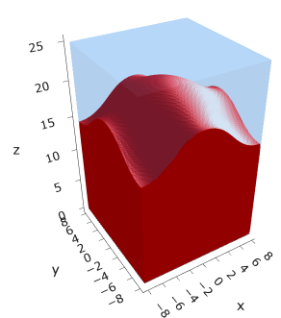
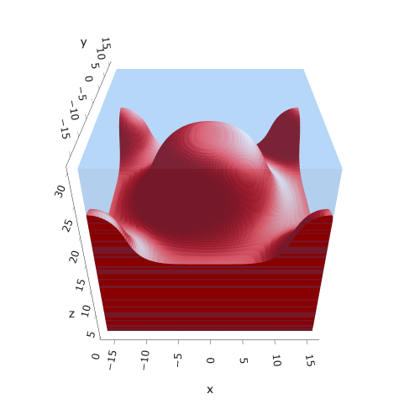
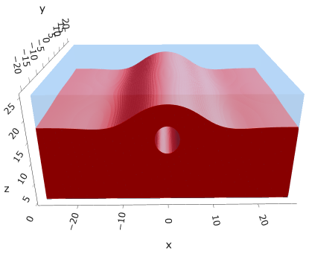
a20s015
F = -8.43926
F = -8.43902
F = -8.43912

Slide 13



a20s022
F = -12.3420
F = -12.3429
F = -12.3433

Slide 14




a20s025
F = -14.0028
F = -14.0029
F = -14.0033
F = -13.9755

Slide 15




a20s027 - DONE
F = -15.1049
F = -15.1047
F = -15.0898
F = -15.1050

Slide 16



a25s027 - DONE
F = -14.6022
F = -14.6018
F = -14.6015
Mul seems unstable (separation between layers low)

Slide 17

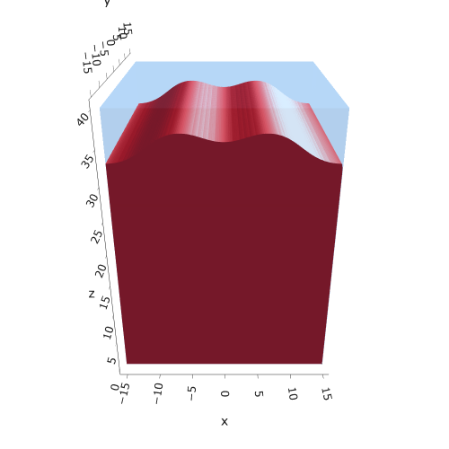
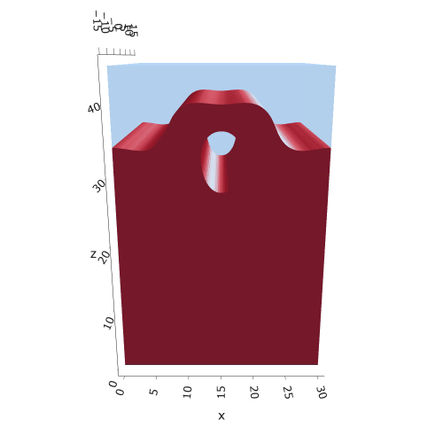

a25s030
F = -16.1887
F = -16.1857
F = -16.1852
F = -16.1894

Slide 18
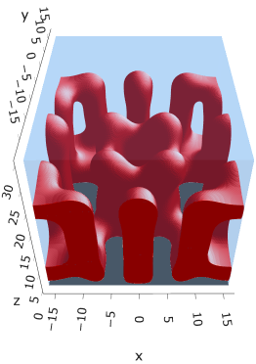
a30s005
F = -2.68749

Slide 19

a30s015

Slide 20
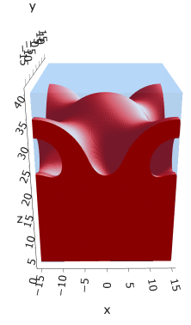


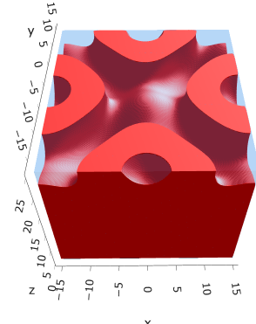
a30s020 - DONE
F = -10.4931
F = -10.4878
F = -10.4764
Hom seems unstable for (0.4, 0.4)

Slide 21



a30s025 - DONE
F = -13.0548
F = -13.0538
F = -13.0394
Cyl?
Mul seems unstable

Slide 22



a30s030
F = -15.5935
F = -15.5884
F = -15.5739
Mic?

Slide 23




a30s0325
F = -16.8477
F = -16.8312
F = -16.8486
F = -16.8268
2C isomin = 0.5

Slide 24





a30s035
F = -18.0779
F = -18.0943
F = -18.0887
F = -18.0887
F = -18.0782

Slide 25


a325s020
F = -10.2994
F = -10.2821

Slide 26




a35s020
Cyl?
3 “layers”
+1 dilute layer < isomin = 0.1

Slide 27





a35
s10
s12
s15
s18

Slide 28



Parallelization
$$α=0, χ=1.25, N=50, σ=0.02$$
$$α=0, χ=1.25, N=200, σ=0.005$$
$$L_{x}=L_{y}=23, { L}_{z}=15$$
Nth = 12: 500 it, 4.3 hrs
Nth = 8 : 500 it, 6.9 hrs
Nth = 6 : 415 it, 20 hrs (poss. mem bottleneck)

Slide 29







Exercise: Micelle / Stripe
s = 5e-03, N = 50, a = 0.0, x = 1.0
s = 5e-03, N = 75, a = 0.0, x = 1.0
Isosurface at pha = 0.1

Slide 30






a040x170s020

Slide 31






a040x170s010

Slide 32

a040x170s025

Slide 33














a040x170s022

Slide 34










a040x170 seed
See if becomes hex
cyl4-975
cyl4-12
cyl16-975
cyl16-1025
cyl1

Slide 35






a040x170s017

Slide 36












































a040x170s015 seed
Almost done
Almost done

Slide 37

















a040x170s013

Slide 38
















a040x170s010 seed

Slide 39














X200 x170 x130 x120 x100
F = −10.24458
F = − 9.14301
F = −11.0057
F = −10.2429
F = −11.0015
F = −9.63949
F = −10.2461
F = −10.9948
F = − 9.63030
F = −10.2431
F = −10.9953

Slide 40





a040x100 relaxation

Slide 41








































a040x100 seed
old
old

Slide 42


a040x120 relaxation
F = −10.24458

Slide 43





































a040x120 seed
cyl16-850
cyl16-825

Slide 44






a040x130 relaxation

Slide 45




a040x170 relaxation
F = −9.10347
1 neck

Slide 46







a040x200 relaxation

Slide 47










a040x200 seed
Note: not completely converged but stopped for resources

Slide 49


a0.40 x1.70

Slide 50





Zhulina JCP 1998
a = 0.01
0.1 mM
1 mM
May need to init using sine
10 mM
25 mM
Zhulina NVT; current GCE runs at Lz = 20

Slide 51

Carrillo Langmuir 2009

Slide 52

Parallelization

Slide 53
Equations
Quenched average, np, A --> \inf ; np/A → \sigma
Discrete Gaussian chain

Slide 54




Scaling (Alexander—de Gennes brush)
V = 4.2; H = 27.5 – 30.5
V = 2; H = 39 – 45.5

Slide 55






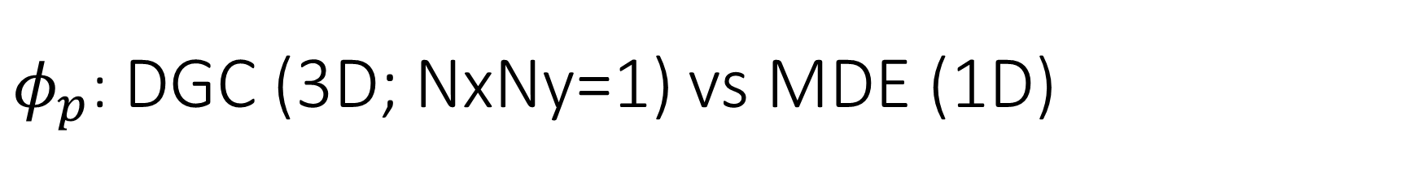
$φ_{p}$: DGC (3D; NxNy=1) vs MDE (1D)
Ns/sigs: dz = 0.10, Ngz_2 = 4$σ$; Chis/bs: dz = 0.25, Ngz_2 = 3.5$σ$

Slide 56


Numericals
Ys
Possibly do Ngz for multiple dzs

Slide 57








3D
Lxy = 1
Lxy = 10
Lxy = 5
Lxy = 15
y-z heatmaps for $φ_{p}$ at constant x

Slide 58





z-FFT vs z-FD (MDE) – REDFT01 xy(z)
Lx = 5, Ly = 5, Lz = 50. s = 0.02. x = 0.75. a = 0.00, N = 50
3D vs 1D (dashed): dz = 0.5, ds = 0.20; dz_1D = 0.113, ds_1D = 0.083
FFT (xyz)
FFT (yz vs pha)
FD (xyz)
FD (yz vs pha)
Diff btw 1D/3D should just be dz, ds, etc.

Slide 59
Specifying Grafted Points

Slide 60
Strategy
2D binary array for surface sites of homogeneously grafted polymer given grafting density, simulation box size, and discretization (and assuming dx = dy)
Fullspace must be periodic on x0 = xL, y0 = yL
Halfspace must be even on xL/2 and yL/2 (overlap of boundary following REDFT00) and periodic on x0 = xL, y0 = yL.
Homogeneous spacing as determined by regular hexagon, where grafting point at centroid of hexagon
In case there are edge effects, try shifting the centroids away from the boundaries of the xy-plane (only did for fullspace)
Make sure no edge effects by comparing results of full FFT with cos FFT

Slide 61
Test conditions
Sigma = 0.05 c/nm2
Lx = 15 nm
Ly = 15 nm
dx = 0.4 nm
Cast in terms of dx (for rounding and PBC for grafting points):
Sigma = 0.0668 c/nm2
Lx = 14.80 nm
Ly = 11.20 nm
(Sigma error decrease with dx)

Slide 62

Padded PBC (Full FFT)
Hexagons drawn for illustration of hexagon approach

Slide 63

Unpadded PBC (Full/Cos FFT)

Slide 64






Other conditions (full and half results overlapped to show match)
s = 0.0241 (20.28%; dx=0.4), Lx, Ly = 12.40, 20.80
s = 0.0208 (4.08%; dx=0.1), Lx, Ly = 12.90, 22.30
s = 0.1332 (11%; dx=0.1), Lx, Ly = 20.50, 20.40

